Slide 1
The Economics of Immigration By Alex Nowrasteh
How Economics Explains Immigration

Slide 2
Immigrants Are People Too
Two very important economic agents:
Labor
Workers.
Entrepreneurs
Innovators.
Business people.
Scientists.
Immigrants are workers and entrepreneurs.

Slide 3
Migration Patterns
(1) Some places have many people and few opportunities.
(2) Other places have abundant opportunities and fewer people.
Migrants move to places with more opportunities and higher incomes.

Slide 4
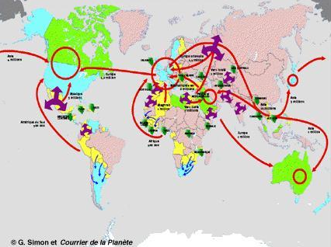

Slide 5
People Move for Higher Income
Costs of moving:
Travel tickets.
Search costs for job, housing, etc.
Government restrictions.
Time off from work.
Psychic costs.
Income in U.S. has to be high enough to compensate for migration.
Immigration slows or stops entirely during recessions in U.S.

Slide 6
Labor “Trading”
Incomes are higher in relatively wealthier countries.
Free markets.
Property and contract rights.
Security.
More capital or land.
Immigrants become more productive in wealthier nations, all else remaining equal.

Slide 7
Average: 5x
Place Premium
Country
Wages in U.S. for Same Worker
Mexico
Guatemala
India
Vietnam
Haiti
3x
3x
6x
6x
10x

Slide 8
Economic Growth From Immigration
Eliminating migration barriers will grow global economy more than anything else.
$29 trillion to $87 trillion: If all global immigration barriers were eliminated today, world production could increase in that range.
Clemens, JEP (2011)
Why? Immigrants are more productive in new countries.

Slide 9
Does Immigration Effect U.S. Income?
Most immigrants are either low skilled or highly skilled. Most Americans are medium skilled.
Most immigrants and most natives do not compete for the same jobs so wages and incomes are mostly unaffected.
Examples:
Miami, 1980-Present.
Los Angeles, 1980-Present.
Europe, 1993-Present.
South Africa, 1993-Present.
U.S., 19th century.

Slide 10
American Losers and Winners
Winners
Losers
Capital owners.
Property owners.
Complementary workers.
Consumers.
Producers.
Low skilled workers.
Some highly skilled workers (maybe).
Older immigrants.
Winner’s Gain + Immigrant Gain > Loser’s Loss

Slide 11
Immigrant Entrepreneurship
In 2010, .62% of immigrants started a business every month (620 per 100,000 immigrants).
In 2010, .28% of natives started businesses every month (280 per 100,000 natives).
Kauffman Foundation, Index of Entrepreneurial Activity (2011)
Immigrants more entrepreneurial than Americans.

Slide 12
Immigrant Firms and Industries
Andrew Carnegie
Born in Scotland.
Immigrated to U.S. in 1848.
From humble origins, he founded firms that became U.S. Steel.
Net worth: $298 billion (2007 dollars).
Forbes

Slide 13
Immigrant Firms and Industries
Sergey Brin – Google
Andy Grove – Intel
Pierre Omidyar – eBay
Jerry Yang – Yahoo!
Andy Bechtolsheim – Sun Microsystems
Vinod Kholsa – Sun Microsystems
Milan Mandarić – Sanmina-SCI

Slide 14
Immigrants Are Positively Selected
Immigrants are more productive than most people from their home country. Energetic, intelligent, ambitious, and educated people leave.
Immigrants to U.S. are more productive than 50% of the people in their home countries but less productive than 30%, on average.
Mexican immigrants are more skilled than 56% of the population in Mexico.
Clemens, Montenegro, and Pritchett (2008).

Slide 15
Restrictions on Immigration
Quotas.
Fees.
Deportations.
Application processes (forms, bureaucracy, lawyers, wait times, etc.)
Workplace regulations (I-9, E-Verify, national ID, etc.)

Slide 16
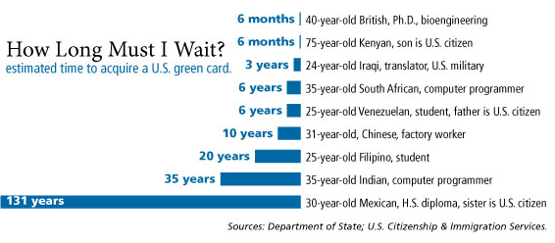
Green Card Wait Times

Slide 17
