Slide 1
healthfinder.gov Provides Technologies to Support Better Health Care Ellen Langhans, MA Dialogue on Diversity Symposium May 20, 2015

Slide 2
Presentation Overview
Office of Disease Prevention and Health Promotion background
Health IT, health literacy, and healthfinder.gov
healthfinder.gov API and content syndication – bringing important prevention information to more people through the use of technology

Slide 3
Office of Disease Prevention and Health Promotion (ODPHP)
ODPHP creates policy and provides guidance, tools, and resources to help Americans live healthier lives
Our work on a wide array of health topics supports both consumers (e.g., healthfinder.gov) and health professionals (e.g., Healthy People 2020, Dietary Guidelines for Americans, etc.)
Notes:
Located within the Office of the Assistant Secretary for Health, the Office of Disease Prevention and Health Promotion (ODPHP) initiates, develops and coordinates disease prevention and health promotion activities, programs, policies, and information across agencies within the Department of Health and Human Services.
By aligning public health policy, science, and communication, ODPHP makes it possible for the HHS Secretary, and often the President, to speak with a single voice on preventing disease and promoting health.
ODPHP is comprised of 4 primary Divisions: Health Communication and eHealth; Healthcare Quality; Prevention Science; and Community Strategies.

Slide 4
Healthy People: Health Communication and Health Information Technology Topic Area
Co-lead with CDC and Office of the National Coordinator for Health Information Technology
Goal: Use health communication strategies and health information technology (IT) to improve population health outcomes and health care quality, and to achieve health equity.
24 objectives around broad categories:
Increasing health literacy skills
Supporting shared decision-making between patients and providers
Increasing Internet and mobile access
Building social support networks
Delivering accurate, accessible, and actionable health information
Increasing the proportion of quality, health-related websites
Facilitating the meaningful use of health information technology and exchange of health information among health care and public health professionals
Enabling quick and informed action to health risks and public health emergencies
Providing sound principles in the design of programs and interventions that result in healthier behaviors
Notes:
http://www.healthypeople.gov/2020/topicsobjectives2020/overview.aspx?topicid=18
Health Communication was recognized as an independent, cross-cutting topic and added to Healthy People 2010, reinforcing the importance of this issue at a national level. With the increasing focus on information technology, this Topic Area was expanded to Health Communication/Health Information Technology in Healthy People 2020.
ODPHP co-leads this topic area with the Centers for Disease Control and Prevention and the Office of the National Coordinator for Health Information Technology
Topic area consists of 24 health communication and health information technology objectives. By combining health information technology tools with effective health communication strategies and processes, these objectives have the potential to improve population health outcomes and health care quality and to achieve health equity.
The broad categories of objectives in this Topic Area include:
Increasing health literacy skills;
Supporting shared decision-making between patients and providers;
Providing personalized self-management tools and resources;
Increasing Internet and mobile access;
Building social support networks;
Delivering accurate, accessible, and actionable health information that is targeted or tailored;
Increasing the proportion of quality, health-related websites;
Facilitating the meaningful use of health information technology and exchange of health information among health care and public health professionals;
Enabling quick and informed action to health risks and public health emergencies;
Providing new opportunities to connect with culturally diverse and hard-to-reach populations; and
Providing sound principles in the design of programs and interventions that result in healthier behaviors.

Slide 5
healthfinder.gov: Live Well. Learn How.
Designed using health literacy principles
Evidence-based prevention focus
Wellness: Health Topics A-Z
Preventive Services: myhealthfinder
Notes:
So before I tell you about our experience in going mobile, I want to give you some quick background on healthfinder.gov, which was the basis for our mobile app challenge.
healthfinder is a user-tested website providing decision support on a number of prevention and wellness topics. The site was designed based on formative and usability research with 700+ people, including those with limited health literacy.
Recommendations on healthfinder come from the U.S. Preventive Services Task Force, the Advisory Committee on Immunization Practices (ACIP), the Bright Futures Guidelines for children, and the Institute of Medicine’s (IOM) Committee on Preventive Services for Women.

Slide 6
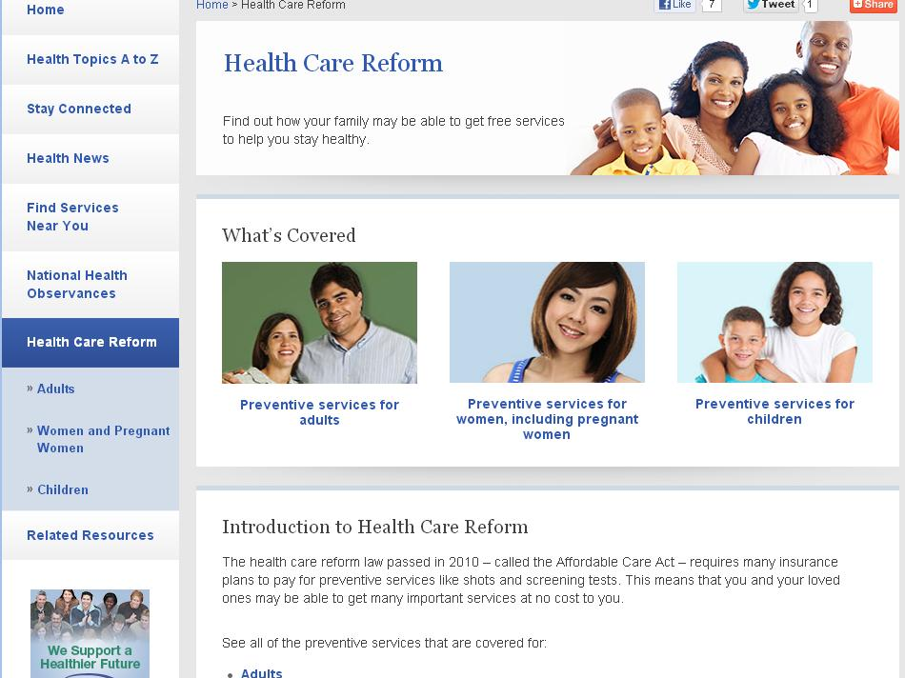
Notes:
With a lot of attention on the ACA and open enrollment, it’s very critical that consumers of health information are able to navigate the complex landscape of coverage options and health plans.
Healthfinder is a face of health reform for consumers. We provide information about preventive services that are covered under the ACA. Users can search by life stage to browse an alphabetical list of available services, and we link to more information on healthcare.gov. We also provide decision support about ACA-covered preventive services through our social media community on Twitter and Facebook.
I’d like to acknowledge here that the Office of the Assistant Secretary for Health has been very supportive about our health literacy efforts, and has participated in some of our HHS Health Literacy Working Group events. The Assistant Secretary has co-authored two Health Affairs articles focused on making health literacy an integral part of healthcare, and authored a blog post for the Huffington Post about the importance of health literacy in communicating about the ACA.

Slide 7
Notes:
From the healthfinder homepage, users can find information on a number of health topics, like nutrition and physical activity or pregnancy. Each topic contains plain language information, ways to take action, and tips and tools, like shopping lists or checklists to prepare for a doctor’s visit.

Slide 8
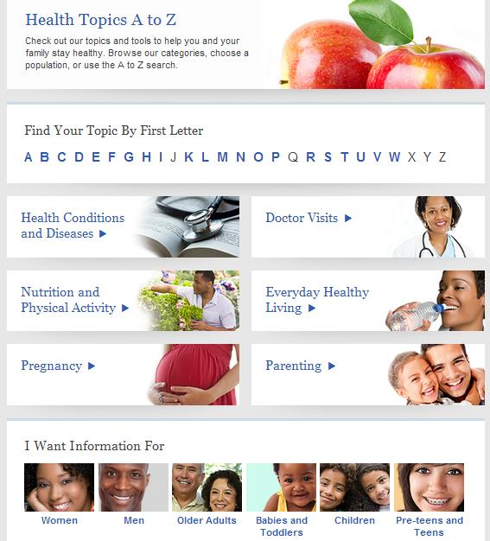
Health Topics A-Z
Search for prevention info by:
Alphabetical
order
Health topic
Life stages
Notes:
Healthfinder users can also browse a wide selection of health topics either by letter, health topic, or life stage.

Slide 9
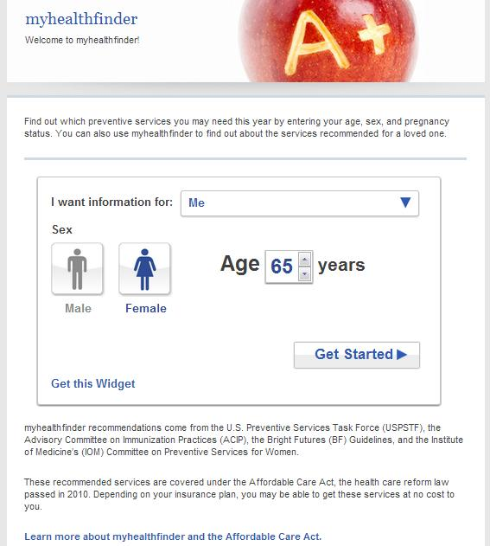
myhealthfinder
Find personalized prevention info based on:
Sex
Age
Pregnancy Status
Notes:
The myhealthfinder widget lets people find personalized health information based on their age, sex, and pregnancy status.

Slide 10
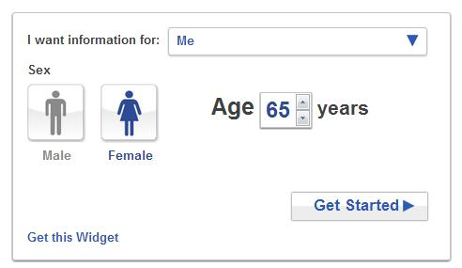
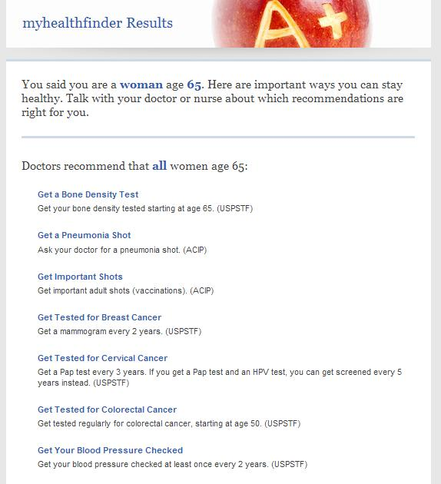
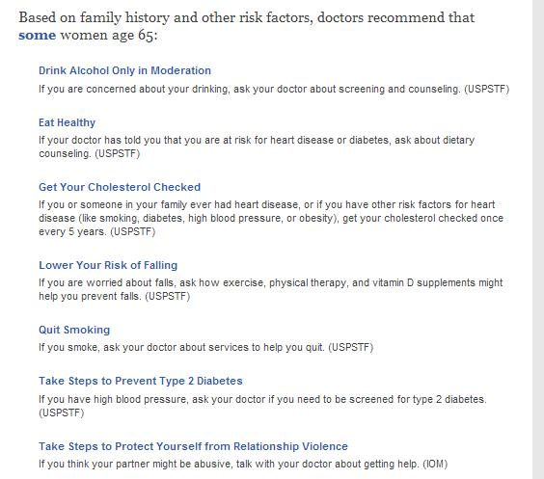
Results Page
Notes:
Here’s an example of the results from a female who is 65 years old. The page recommends a number of screenings based on current preventive guidelines.

Slide 11
So why expand technologies?
Digital Government Strategy
Cell phone use in the U.S.
56% of adults own smart phones
19% of adults have downloaded health apps
Access to underserved populations
Content syndication and responsive design
Enhance program offerings and brand awareness
Notes:
So why go mobile? The digital government strategy was a key driver for us. We wanted our community of health consumers to access health literate prevention information from their personal devices. (The digital government strategy lays out actions in a 12-month roadmap aimed at ensuring that the American public can access digital content anytime, anywhere, from any device.
It has three main objectives:
Enable the American people and an increasingly mobile workforce to access high-quality digital government information.
Ensure that as the government adjusts to this new digital world, we seize the opportunity to procure and manage devices, applications, and data in smart, secure and affordable ways.
Unlock the power of government data to spur innovation and improve the quality of services for the American people)
We also assessed mobile use in the U.S. A recent Pew Internet report showed that 56% of adult own smart phones; this is up from 46% at the time the digital government strategy was released. 19% of adults have downloaded health apps, which is also encouraging. Also, the mobile landscape opens access the harder-to-reach, underserved audiences who own smartphones and not personal computers.
Content syndication and responsive design provide opportunities to package your health content and provide it on other websites or digital platforms. At ODPHP, we created an API – or application programming interface – for our consumer-facing website, healthfinder.gov, so that developers could lift the vetted content from the site. We also developed a responsive design, so that healthfinder.gov would still be easy to navigate from a browser on a phone or tablet.
Last, expanding to the mobile space allows you to enhance your program offerings and expand your brand to people’s personal devices.

Slide 12
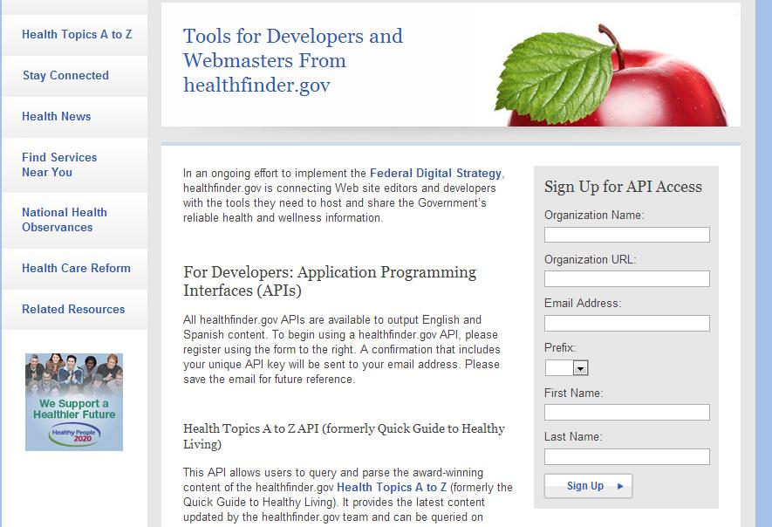
Content Syndication and API
Notes:
If you don’t have resources or time to provide up-to-date prevention and wellness information, let us do the job for you.
healthfinder.gov Content Syndication lets you add easy-to-read, actionable and accurate information to your library’s Web site—in as little as five minutes. The tool is free and simple to add or delete—you choose which topics you want to display. Whenever content is updated on the site, it is automatically updated on your site as well. Easy to use, and to maintain.
The Health Topics A to Z API allows users to query and parse the award-winning content of the healthfinder.gov Health Topics A to Z. It provides the latest content updated by the healthfinder.gov team and can be queried on demand and parsed for immediate presentation.

Slide 13
healthfinder API – bringing important prevention information to more people
The healthfinder API “opens up” the Health Topics A-Z content and the myhealthfinder results to an application programming interface, allowing others to interact with the content as they see fit – whether it’s in another website or mobile applications, etc.
With these easy-to-use tools, content is broken down on a granular level so API users can easily display the content they want in the ways they want
Smaller organizations (with smaller budgets) can use these free tools to share important prevention information with their constituents

Slide 14
Thank You! Ellen Langhans ellen.langhans@hhs.gov

