Slide 1
Imagining a (Real?) Culture of Health
Laura MacCleery, Center for Science in the Public Interest
Dialogue on Diversity 2015
Notes:
I’m Laura MacCleery with the CSPI, a 40-year old DC based non-profit that focuses on better choices for consumers in terms of public health and greater accountability and transparency for food producers. Do stretch and wiggle.

Slide 2
What is “healthy” food, anyway?
Natural?
Local?
Organic?
Vegetarian?
Chemical-free?
Affordable?
Notes:
Food is cultural, embedded with a wide range of values, and also a daily necessity. We bring a lot of ideas and habits both to food choices. The discussion of what’s “healthy” is just one vector – and even this question is a loaded one, filled with our ideas of the kind of world we’d prefer, sometimes the guilt and self-consciousness we feel in the face of so much advice about what to eat, and the noise of a marketplace in which food makers often try to tout foods as healthier than they are.

Slide 3
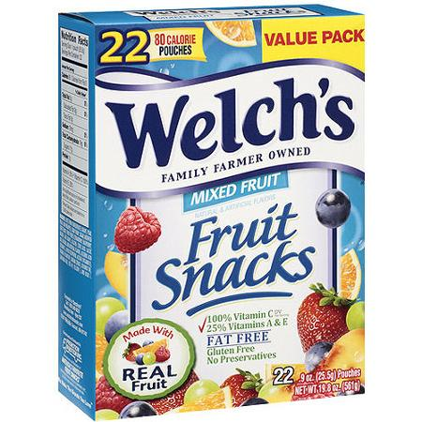
“Fruit” Snacks?
Made with real fruit (!)
No preservatives (!)
100% vitamin C daily value per serving (!)
25% vitamins A and E daily value per serving (!)
Gluten free (1)
22 Packages for $3.98
Ingredients:
Juice from Concentrates (Grape, Pear, Peach, And Pineapple), Corn Syrup, Sugar, Modified Corn Starch, Fruit Purees (Strawberry, Raspberry, Orange, And Grape), Gelatin, Citric Acid, Lactic Acid, Natural And Artificial Flavors, Ascorbic Acid (Vitamin C), Alpha Tocopherol Acetate (Vitamin E), Vitamin A Palmitate, Sodium Citrate, Coconut Oil, Carnauba Wax, Red 40, Yellow 5, And Blue 1.
Notes:
Snack with purpose when you bite into Welch's Mixed Fruit Fat Free Fruit Snacks. Made with real fruit and enhanced with essential daily vitamins, you can satisfy your cravings and improve your diet. These Welch Fruit Snacks are, like all Welch products, built on the highest quality fruit grown proudly on family farms. Traditional goodness from real fruit and fruit juices makes these mixed fruit snacks a superior mid-meal food. Each serving of Welch's Mixed Fruit Fat Free Fruit Snacks contains 100 percent of your daily recommended vitamin C and 25 percent of your daily recommended vitamin A and E. Gluten-free and delicious, these fat-free fruit snacks are sure to delight event he pickiest eaters. Always delicious and always preservative free, try all the delicious varieties of Welch's Mixed Fruit Fat Free Fruit Snacks.
Sounds like a health food? What’s in it? Juice from concentrates = sugar. Corn Syrup is sugar. Sugar is sugar. Then some starches. So after three sugars and a starch, we get to the fruit purees, which is some amount of fruit stripped of fiber and also high in sugar. Then gelatin, flavors, added vitamins (because the fruit would largely lack them after being so refined), wax and food dyes, which are needed to create the fruity colors.

Slide 4
Healthy food, defined
Dietary Guidelines for Americans, 2015 expert report:
Higher in fruits and vegetables, nuts and whole grains, and lower in salt, sugar and fat (and red and processed meat).
Or a broader definition of “good food:”
“healthy, green, fair and affordable.”
Notes:
The Dietary Guidelines experts met for the past 18 months and came up with the same recommendation, basically, that has been true for several decades. We know what healthier eating is. Wait for it…
In addition, I like to think about a justice-based element, a situational environmental element, a worker protection element and a financial element. Our food system produces injustices and suffering all along the the production line, from migrant workers in the fields, to the suffering of industrially farmed animals, to the back kitchens of restaurants, and then again in our health. We could spend a lot of time unpacking all of this. For today, I will focus on the gap between the health the food is supposed to give us and our current food environment.

Slide 5
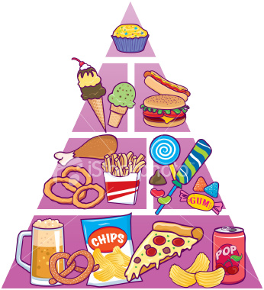
Notes:
Let’s face it, instead of following any Guidelines, this is how we know Americans actually eat too much of the time. Our diet is full of sugars, salts and fat in excess. The Guidelines committee concluded that a full one-third of our national diet is comprised of burgers, sandwiches, pizza, dessert, sweet snacks and sugary beverages.

Slide 6
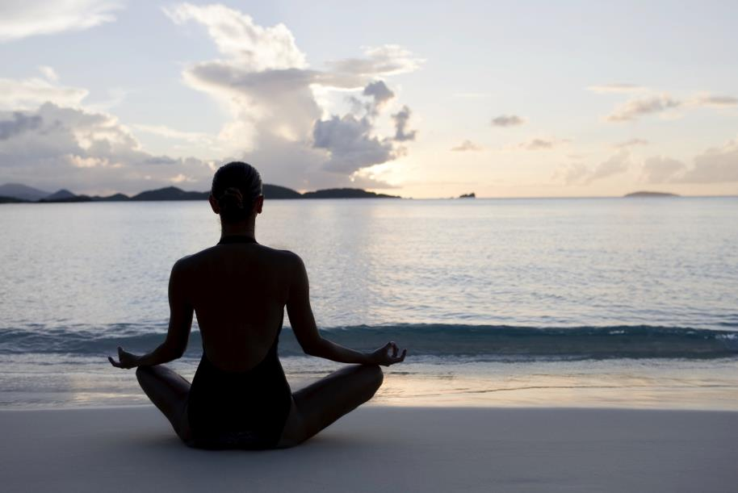
Notes:
This is obviously not what my life looks like, I don’t know about you! One issue is that we think of health as unattainable and perfect. As doing yoga on a beach somewhere. Health as a luxury good. As you might think, the notion of the healthy life as something unattainable masks the harmful impacts of our constructed food environment.

Slide 7
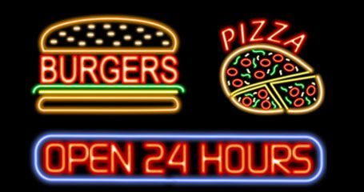
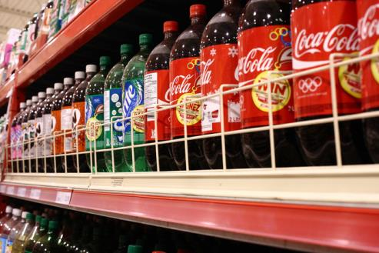
Notes:
Back to reality, we have ubiquitous bad choices, convenience fare, and an over-abundance of cheap, unhealthy options.

Slide 8
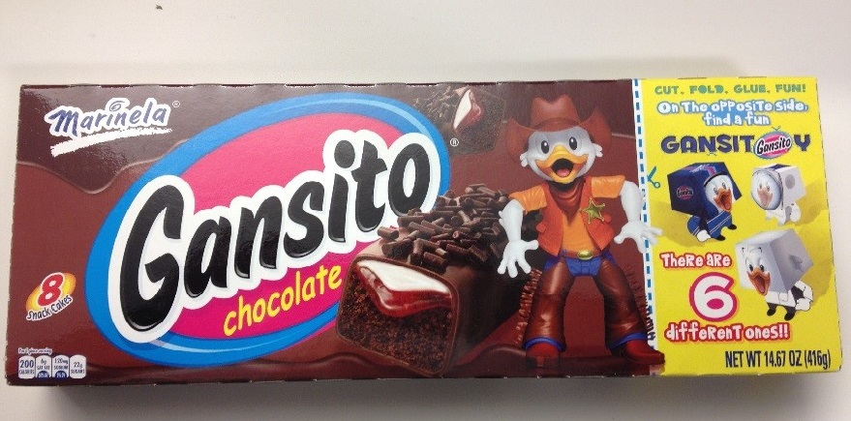
Target Marketing
Notes:
We also have junk food that is explicitly marketed to children, and even to low-income communities of color, complete with games, cartoon characters and other gimmicks that I know, as the mother of a 4-year-old are designed to make parents’ jobs that much harder.

Slide 9
A Food Environment that Impacts Health
“Food systems generate and exacerbate key health disparities in the United States.”
Health disparities refer to gaps in health status (e.g., life expectancy, infant and maternal mortality rates, obesity and diet-related disease, and other measures) among groups of people based on differences in factors such as socioeconomic status (SES), race, ethnicity, immigration status, environmental exposures, gender, education, disability, geographic location, or sexual orientation.
—Johns Hopkins Center for Livable Future 2015
Notes:
Here’s our working definition from a recent report of health disparities and the key conclusion in the report.

Slide 10
Major Sources of Health Disparities
Lower income, ethnic minority, less educated, inner-city, and/or rural communities are especially likely to have food options dominated by less healthy offerings, due to physical, social, and economic access and marketing and cultural factors.
Predominantly minority, low-income, and rural communities have less access to healthier foods. Corner stores offer processed foods and few fresh items, while healthier food is more available in white than non-white communities.
Nutrient-dense foods like fruits and vegetables are more expensive than foods with higher sugar, salt and fat content.
11.1% of Americans have “low food security” and 4.1% have “very low food security:” African Americans and Latinos estimated to have double these national rates. Food insecurity is highly correlated with obesity.
Notes:
Also, work environment in the food system, family income, and loss of time for food preparation.

Slide 11
Junk Food Marketing
Audience segmentation in content and placement is a basic tenet of marketing.
Studies found that more food commercials aired during “African American” shows than others, and that the distribution of items advertised was more heavily skewed toward unhealthy items.
Lower-income children watch more television and have greater media exposure—and thus more exposure to food commercials—than their higher-income peers.
Children of color get a “double dose” of marketing: both general and racially targeted efforts.

Slide 12
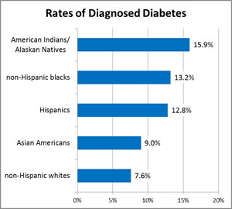
A Disproportionate Disease Burden: Diabetes

Slide 13
Heart and Liver Disease
Age-adjusted death rates for cardiovascular disease are 33% higher for African-Americans than for the overall population in the U.S.
African-Americans are nearly twice as likely to have a first stroke and much more likely to die from one than whites.
Hispanics are 50% more likely to dies from liver disease than are non-Hispanic whites.
American Indians/Alaska Natives die from heart disease much earlier than expected – 36% are under 65 compared with only 17% for the U.S. population overall.

Slide 14
Solutions?
A comprehensive, coordinated system-wide approach:
Multiple intervention points are far more effective than single changes. And education is less likely to be successful if the surrounding environment does not empower consumers.
Multi-component obesity prevention approaches in child care settings, schools, and worksites can improve diet.
Because food insecurity and food access impact the quality of diet, ensuring that policies address these hurdles with concrete change is essential.
We need actionable, common-sense public policies that transform our food environment into one that supports a culture of health.
Notes:
CSPI is working across the food environment for changes that encourage healthy foods: labeling, institutions, checkout, marketing – all are important areas for improvement.

Slide 15
Transforming the Food Environment
Greater Transparency: Front-of-package labeling to show healthier and less healthy foods; less deception in labeling (regulation, legislation, litigation).
Changing Institutions and Defaults: School foods, Child care center offerings, Vending machine calorie labeling; Calorie labeling at restaurants; Healthy check-out; government purchasing; healthy meetings.
Marketing: Voluntary limits on junk food marketing to children; government monitoring of predatory practices;
Consumer awareness: Health campaigns and literacy programs; NFP; taxes and incentives.

Slide 16
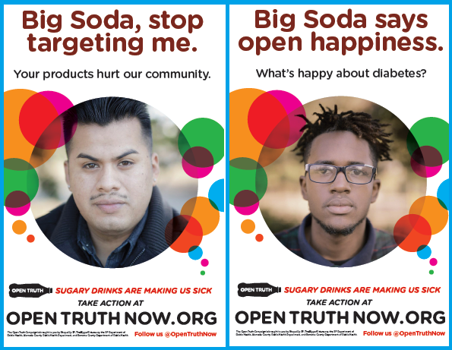
We also need energy, young people & a critique that empowers…
The Bigger Picture is a collaboration between Youth Speaks, and the University of California, San Francisco Center for Vulnerable Populations designed to combat the rising epidemic of Type 2 Diabetes by empowering youth to change the conversation about the disease, and work to change the social and environmental factors that have led to its spread.
Notes:
We also need inspiration! Now I would like to show a short and powerful video by the Bigger Picture.com, an exciting project that uses spoken word and young people to criticize the health impacts of the food system. This is Obasi Davis, a Bay area spoken word artist.

Slide 17
Thank you.
lmaccleery@cspinet.org
Notes:
I’d love to continue this conversation and hear your ideas about how to get greater awareness of health impacts around food in communities of color. What are barriers and how can we do a better job?

