Slide 1
Health Insurance Marketplace
Affordable Care Act outreach to Latinos
May 20, 2015
Jeanette Contreras, MPP
Centers for Medicare and Medicaid Services
Jeanette.Contreras@cms.hhs.gov

Slide 2
Marketplace Open Enrollment Report
From November 15, 2014 – February 15, 2015
About 11.7 million selected a plan or were automatically re-enrolled in a Marketplace plan
8.6 million in Healthcare.gov states
2.8 million in State-Based Marketplaces
Since Open Enrollment October 2013
Nearly 10.8 million Additional Individuals enrolled in Medicaid or the Children’s Health Insurance Program (CHIP) as of December 2014
Tax Special Enrollment Period March 15-April 30
147,000 consumers signed up through HealthCare.gov
Notes:
So I couldn’t be happier to tell you that during open enrollment we’ve enrolled about 11.6 million and counting.
Of those enrolled,
8.6 million were enrolled in the 37 states that used Healthcare.gov and
2.8 mil in enrolled in State-Based Marketplaces, like through Covered California or NewYorkStateofHealth sites.
It’s also exciting to report that as of December 2014, we’ve enrolled an additional 10.8 million individuals in Medicaid and Chip since the beginning of the first open enrollment.
Currently 28 states, plus the District of Columbia, have provided greater access to health care coverage to uninsured low-income individuals by expanding Medicaid coverage through the Affordable Care Act.
Also, From March 2015 to April 30- 147,00 additional consumers signed up for coverage using the tax special enrollment period. This was only implemented in FFM states

Slide 3
Uninsured Rate Report
The uninsured rate declined by more among African Americans and Latinos than among Whites.
Between Oct. 2013 and March 2015 -
4.2 million Latino adults gained coverage (a 12.3 percentage point drop);
2.3 million African American adults gained coverage (a 9.2 percentage point drop); and
6.6 million White adults gained coverage (a 5.3 percentage point drop).

Slide 4
Latino Outreach and Enrollment
Working with trusted partners
Civic groups such as LULAC, PPFA, NCLR, NHMA, NLIRH, PPFA, Hispanic Federation, Voto Latino
White House Initiative on Educational Excellence for Hispanics to reach HSIs, community colleges and trade schools
Utilizing enrollment summits
Hosted in target markets across the country; in Federally Facilitated Marketplace states: AZ, FL, GA, NJ, PA, TX, VA
Engaging specialty media
Spanish-speaking radio stations, television, online and print publications; Telemundo, Univision, CNN en Espanol
Notes:
Working with trusted partners in the community which include civic groups such as the League of United Latin American Citizens (LULAC), National Council of La Raza (NCLR), Hispanic Federation, National Urban League,
health focused organizations including the National Hispanic Medical Association (NHMA), the National Association of Hispanic Nurses, The National Latina Institute for Reproductive Health (NLIRH), Planned Parenthood, and
social media groups with a large following such as Latism.
We have also partnered with the White House Initiative on Educational Excellence for Hispanics to engage Hispanic Serving Institutions (HSIs) and community colleges or trade schools to host and help promote local enrollment events.
Utilizing enrollment summits across the country to get people enrolled in the priority target markets of Atlanta, GA; Dallas, Houston, El Paso, Rio Grande Valley, TX; Philadelphia, PA; Orlando, Miami, Tampa, FL; North New Jersey, NJ; Phoenix, Tucson, AZ; Northern Virginia, VA.
Engaging with specialty media to get the word out especially with Spanish-speaking radio stations, television, online and print publications so that we can reach where folks are already receiving news updates, and information. Some of these networks include Telemundo, Univision and CNN en Español and their local affiliates.

Slide 5
Leveraging Community Resources
Trusted community based organizations
Churches, pastors, faith-based organizations
Local and municipal agencies that provide social services:
County health, housing, homeless and food banks
Elected officials:
Mayors, Councilmembers, School Board
Local Latino coalitions
Pharmacies and grocery stores
Notes:
Through the work of our regional office staff we were able to support and co-host local community events.
Much of this work was done through formal coalitions in the Latino communities.
Also, we were able to utilize community leaders like elected officials to raise awareness and host events.

Slide 6
Enrollment Challenges
Limited English Proficiency
Fear of immigration enforcement
Low understanding of Health Insurance
Limited access to internet, email or telephone
Belief Marketplace plans are not affordable
Complicated application process
Insurance company notices hard to understand

Slide 7
Improved Enrollment Process for LEP
Bolstered Spanish-language Assistance
Increased number of in-person assisters
Increased number of customer service representatives
Improvements to verification system
Expanded list of documents that can be used for identity verification to include additional immigration documents, foreign passports and foreign identity cards
Added interpretive services for consumers using Experian
Notes:
We made improvements to the verification system.
Many eligible non-citizens who are lawfully present had difficulty in completing the step that verifies their identity because of their unique circumstances.
For example, we expanded the list of documents that can be used for identity verification to include additional immigration documents, as well as foreign passports and foreign identity cards.
We also recently provided new support for consumers needing to complete this process over the phone with Experian by adding interpretive services in more than 200 languages.
We are bolstering assistance available in Spanish.
We are increasing the number of in-person assisters who can speak Spanish.
We are increasing the number of Customer Service Representatives in the call center who speak Spanish.

Slide 8
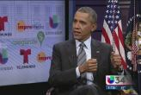
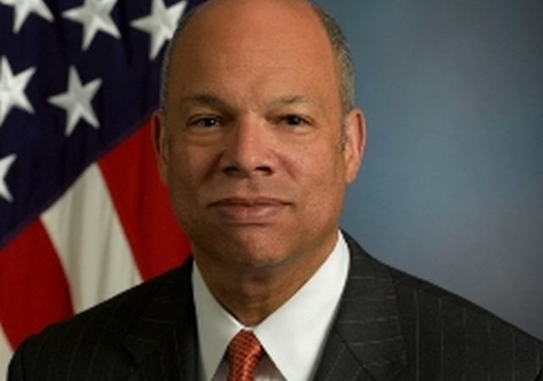
Immigration and the Affordable Care Act
Tu Salud y La Nueva Ley- Latino Town Hall with President Obama about the Health Insurance Marketplace- Televised on Univisión y Telemundo March 7, 2014
Jeh Johnson, Head of the Department of Homeland Security (DHS) ‘sets the record straight’ about the Affordable Care Act for immigrant families. – La Opinión, “Dejando Las Cosas Claras” February 28, 2014

Slide 9
Options for Mixed Status Families
Can apply for a tax credit or Medicaid and CHIP for their dependent family member
Family members who aren't applying for health coverage for themselves won't be asked if they have eligible immigration status.
No 5-year waiting period for Marketplace enrollment
Information provided by applicants or beneficiaries won’t be use for immigration enforcement purposes
Notes:
Many Latino families are of “mixed status,” with members having different immigration and citizenship statuses.
“Mixed status” families can apply for Medicaid and CHIP or for coverage through the Marketplace, where dependent family members may be eligible for programs that help lower the cost of Marketplace health insurance coverage.
People without lawful immigration status are not eligible to enroll in the Marketplace. Medicaid provides payment for treatment for an emergency medical condition for individuals who do not meet the citizenship or immigration status requirements for Medicaid and are otherwise eligible for Medicaid in the state.
It is important to note that information provided by applicants or beneficiaries will not be used for immigration enforcement purposes.
Federal and state Marketplaces and state Medicaid and CHIP agencies cannot require applicants to provide information about the citizenship or status of any family or household member who is not applying for coverage. Family members who aren't applying for health coverage for themselves won't be asked if they have eligible immigration status.
Therefore, mixed status families should not be afraid to enroll their family members in coverage.
Also, applying for Medicaid or CHIP, or getting help with health insurance costs in the Marketplace, does not make someone a “public charge.” And it will not affect their chances of becoming a Lawful Permanent Resident or U.S. citizen.

Slide 10
Undocumented Immigrants
Aren’t eligible for federal public benefits through the affordable care act
May continue to buy coverage on their own outside the Marketplace
Can get limited services for an emergency medical condition through Medicaid
If otherwise eligible for Medicaid in the state
Aren’t subject to individual shared responsibility requirement

Slide 11
A Roadmap to Better Care and a Healthier You
A step-by-step guide
What having health insurance means
How to use your card
How to set up your first visit with a health care provider such as a doctor or a nurse practitioner.
What to expect during that first visit
What to look for in a provider that works for you and your needs

Slide 12
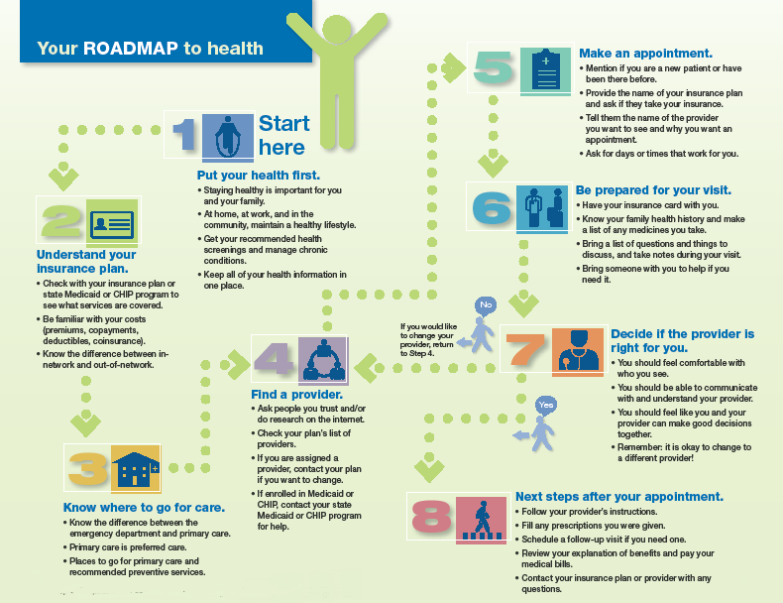
From Coverage to Care
Roadmap (English/Spanish)
Poster Roadmap (English/Spanish)
One-pagers:
Insurance card
Primary care vs. Emergency
Explanation of Benefits
Pull-out steps
Discussion Guide (English)
Video vignettes (English/Spanish)
All resources available at
http://marketplace.cms.gov/c2c

Slide 13
Stay Connected
Sign up to get email and text alerts at HealthCare.gov/subscribe
CuidadoDeSalud.gov for Spanish
Updates and resources for partner organizations are available at Marketplace.cms.gov
Twitter @HealthCareGov / @CuidadoDeSalud
#GetCovered or #Asegurate
Facebook.com/Healthcaregov or CuidadoDeSalud

