Slide 1
Marylouise Kelley
Family Violence Prevention and Services Program
Family & Youth Services Bureau
Administration for Children & Families

Slide 2
FVPSA’s Legacy 1984-2014
www.learnaboutFVPSA.com
First authorized as part of the Child Abuse Amendments of 1984 (PL 98–457), the Family Violence Prevention and Services Act has been amended eight times.
Offering families impacted by domestic violence connections to safety & support for 30 years

Slide 3
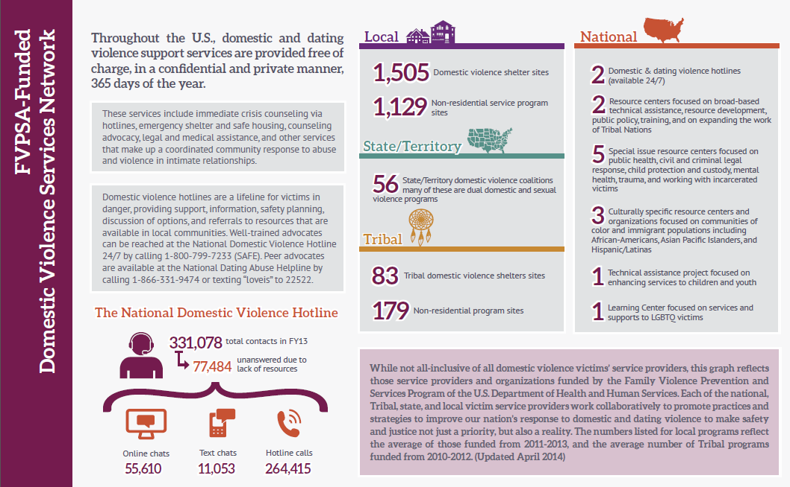
FVPSA Network of DV Services

Slide 4
Getting Help with Domestic Violence
4
Free and confidential help is available for victims of domestic violence 24 hours a day:
National Domestic Violence Hotline
1-800-799-7233
National Teen Dating Abuse Helpline
1-866-331-9474
National Sexual Assault Hotline (RAINN)
1-800-656-4673
http://www.acf.hhs.gov/programs/fysb/resource/help-fv

Slide 5
FVPSA’s Lifesaving Shelter & Services in 2012
1,505 community-based shelters and 1,129 non-residential services offering safe housing, crisis response, advocacy, legal assistance, counseling, safety planning and support groups for 1.3 million adults, youth and children each year.
876, 506 women
76, 813 men
292, 799 children

Slide 6
FVPSA’s Resource Centers & Institutes
Resource Center on DV:
Child Protection & Custody
National Health Resource Center on Domestic Violence

Slide 7
Te Invito
by Casa de Esperanza/ the National Latin@ Network

Slide 8
Our Commitments
Raise grantees awareness about domestic violence, trauma-informed and culturally specific programming
Seek opportunities to foster meaningful partnerships with culturally specific community based organizations
Build partnerships with culturally specific researchers and culturally specific community based organizations to bolster the evidence base
Prioritize training and partnerships to increase linguistic and culturally specific accessibility of services

Slide 9
FVPSA’s Partnership Vision Agencies will have the ability to:
Recognize
Recognize domestic violence and its impact;
React
React appropriately, with trauma-informed strategies; and
Refer
Refer victims and their children to appropriate assistance
Notes:
3.3.6 Establish common standards for ensuring that health and human service providers supported by ACF have the capacity to:
Recognize the impact of domestic violence;
Respond effectively; and
Safely link participants to domestic violence services.

Slide 10
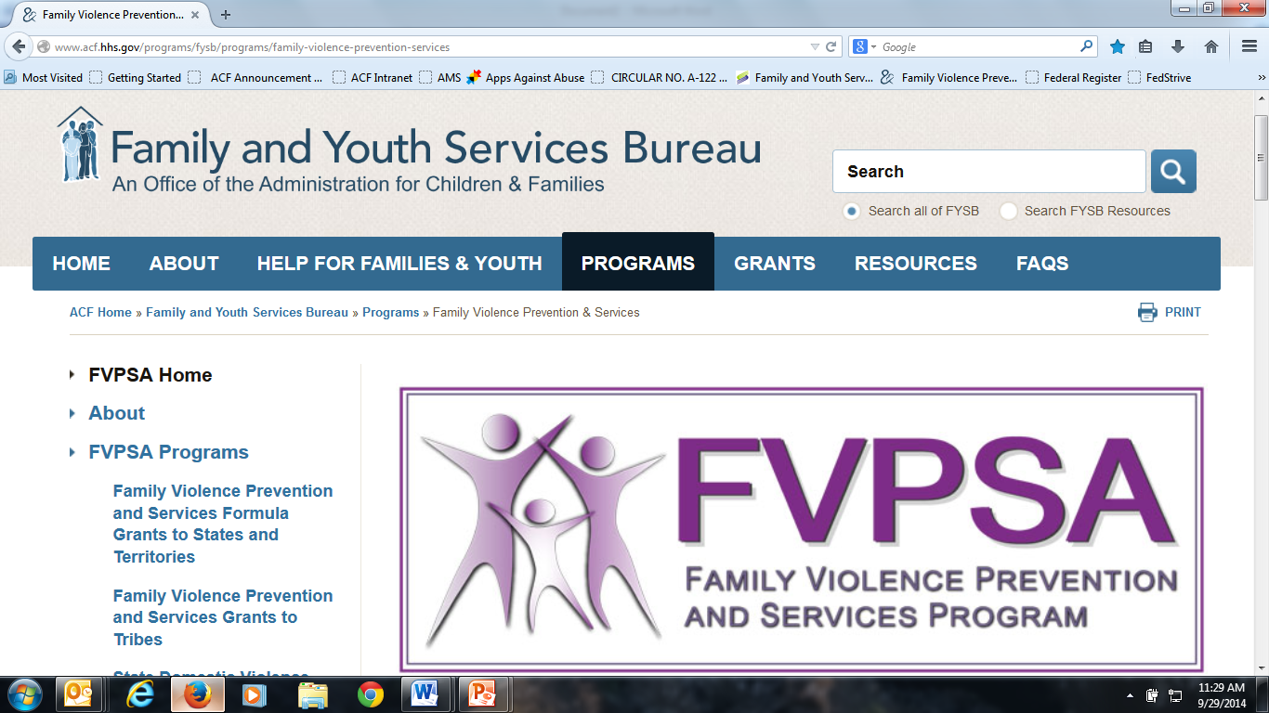
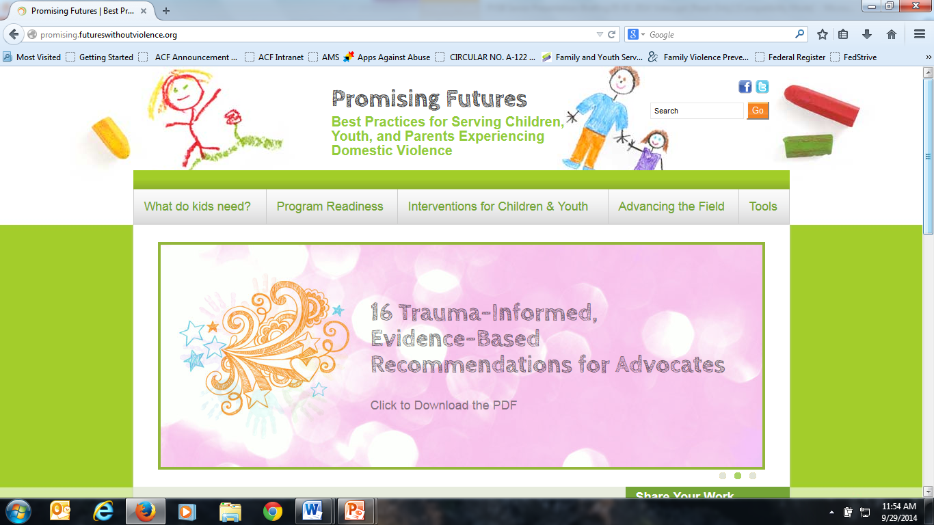
Education Efforts: FVPSA Website www.acf.hhs.gov/fvpsa
Articles: DV research, best practices, and training tools
Getting Help with Domestic Violence
Resources: Health Cares about IPV, DV Evidence Project, & Promising Futures Without Violence
Notes:
The new FYSB website has given us an additional platform to communicate ACF and ACYF priorities around safety and wellbeing. We are also able to highlight grantee successes. We feature 2-3 articles a month on ACYF priorities, as well as disseminate useful quick fact information that pertains to many aspects of the RHY programs.

Slide 11
Visit LearnAboutFVPSA.com
11

Slide 12
Contact
Marylouise Kelley, Ph.D., Director
Family Violence Prevention & Services Program
Family & Youth Services Bureau
Administration for Children & Families
U.S. Department of Health & Human Services
Marylouise.Kelley@acf.hhs.gov
www.acf.hhs.gov/fvpsa
www.acf.hhs.gov/programs/fysb
www.learnaboutfvpsa.com

