Slide 1
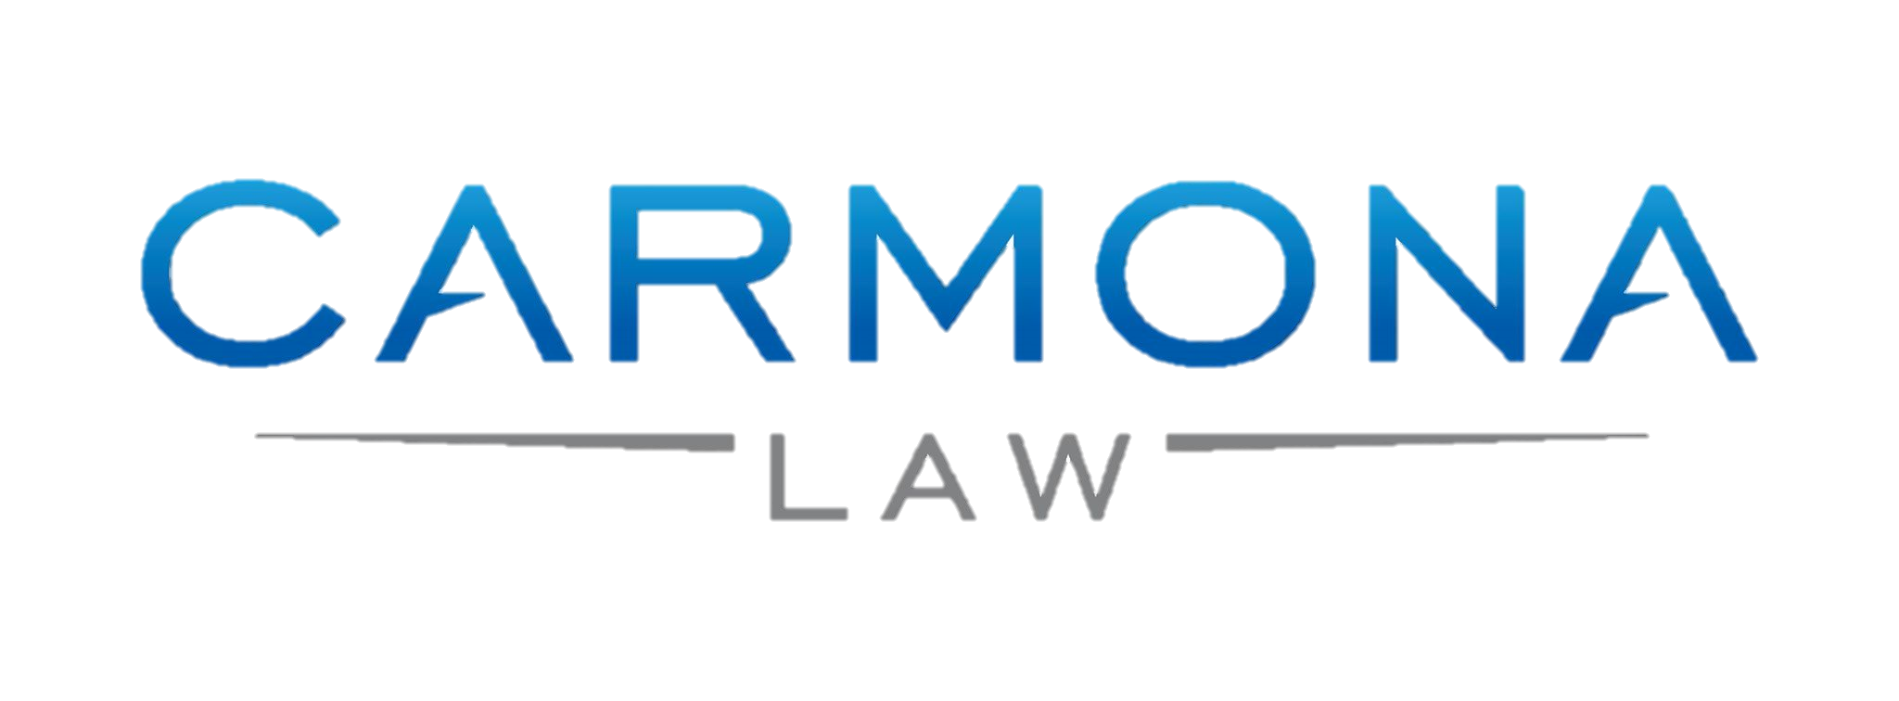
How it can make or break your business
Prepared especially for
Dialogue on Diversity – Entrepreneurship Information Technology Conference
By: Omar Carmona, Esq.
September 13, 2016

Slide 2
A Contract
Defined as an agreement creating obligations enforceable by law.
Notes:
A business can be saved or taken down by a single document: a contract. A contract is defined as an agreement creating obligations enforceable by law.

Slide 3
Basic Elements of a Contract
Mutual assent
Consideration
Capacity
Legality
Notes:
The basic elements of a contract are mutual assent, consideration, capacity, and legality.

Slide 4
ONE thing in common:
Contracts are negotiable; all you have to do is ask.
Notes:
All contracts are negotiable; all you have to do is ask. Parties enter into a contract with mutual aspirations and, generally, everyone have one thing in common: performance.

Slide 5
If the situation is too good or too inexpensive;
it will be very bad and very expensive in the future.
WALK AWAY!
Notes:
As a business owner, you must strive for all contracts to be under the name of your company. If a person or entity does not want to sign a contract to do business with you, save time and save your business and simply walk away. If the situation is too good or too inexpensive; it will be very bad and very expensive in the future.

Slide 6
Personal Guarantor
If it is unavoidable, then consider the following:
do not ask to be a guarantor
request for an end date: typically one year
offer to prepay months and then do a step down
offer collateral
offer a larger security deposit
Notes:
Most contracts for a new business require the use of a personal guarantor. If it is unavoidable, then consider the following:
-do not ask to be a guarantor
-request for an end date: typically one year.
-offer to prepaid months and then do a step down
-offer a collateral
-offer a larger security deposit

Slide 7
Most important for a business relationship
Avoid liability
Hold some type of leverage
Notes:
A business can be saved or taken down by a single document: a contract. Other than forcing the other party to act or to comply, the main two things a business wants to do in a business relationship is to avoid liability and to hold some type of leverage.

Slide 8
Look for SUBSTANCE
Notes:
Most of the time the what big print in a contract gives the small print takes it away. A contract does not have to be extensive; it needs to have substance. Everything should be in the contract.

Slide 9
Basic Elements of a Contract
Venue and jurisdiction
Who is paying for the breach and enforcement of the terms of the contract: attorney’s fees?
Establishing precedent conditions
Liquidated damages
Reason to walk away
Mutual assent
Consideration
Capacity
Legality
Notes:
The basic elements of a contract are mutual assent, consideration, capacity, and legality. We should add the following to any business contracts:
1. Venue and jurisdiction
2. Who is paying for the breach and enforcement of the terms of the contract: attorney’s fees?
3. Establishing precedent conditions
4. Liquidated damages
5. Reason to walk away

Slide 10
A contract can make or break your business!

Slide 11
Omar Carmona, Esq. carmona@OCarmonaLaw.com 407.775.2727

