Slide 1
Better Solutions for Better Lives
Dialogue on Diversity
Culture, Language and
Health Literacy
Kinte Ibbott, MPH

Slide 2
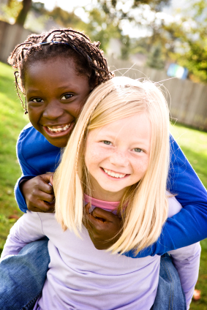
Established Partner for Government Social Programs
Leading Provider of Government
Health and Human Services Worldwide
Founded in 1975 and headquartered in Reston, Virginia
Approximately 11,000 employees across the United States, Canada, the United Kingdom, Australia and Saudi Arabia
History of serving more than 4,000 U.S. government clients:
All 50 states, the District of Columbia, several territories
Every major city and county
Multiple federal agencies and departments, including HHS (CMS), SSA, VA, DOJ and OPM

Slide 3
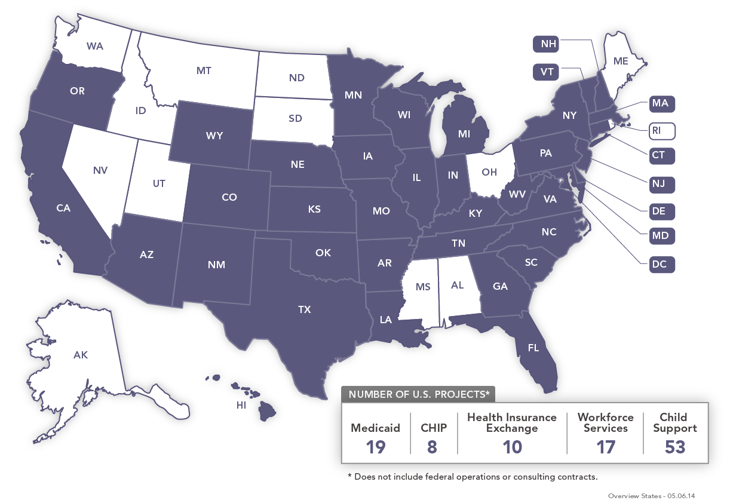
U.S. Health & Human Services Programs

Slide 4
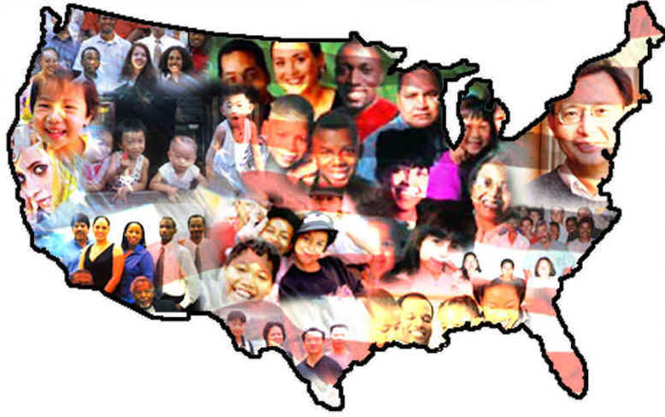
Communities we touch......

Slide 5
Definition of Health
As defined by World Health Organization (WHO), it is a "State of complete physical, mental, and social well being, and not merely the absence of disease or infirmity."

Slide 6
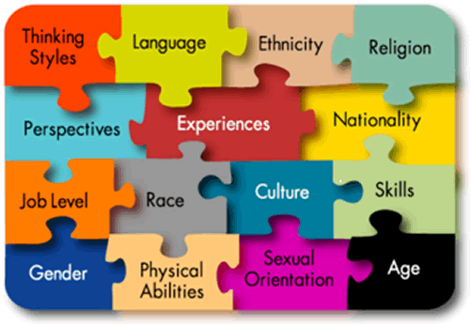
Culture and language influence health
Culture affects how people communicate, understand, and respond to health information.
They influence:
Health, healing and wellness belief systems
Illness, disease and how causes are perceived
How health care treatment is sought and attitudes toward providers, impacting treatment

Slide 7
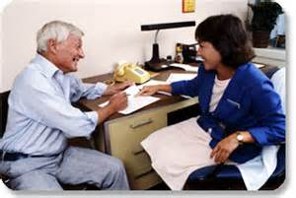
The “pursuit” of cultural competence
Cultural competence is the ability of health organizations and practitioners to recognize the cultural beliefs, values, attitudes, traditions, language preferences, and health practices of diverse populations, and to apply that knowledge to produce a positive health outcome.
Competency includes communicating in a manner that is linguistically and culturally appropriate.

Slide 8
Health Literacy and Patient Engagement
Health literacy is the degree to which individuals have the capacity to obtain, process, and understand basic health information and services needed to make appropriate health decisions
Health literacy affects people's ability to:
Navigate the healthcare system, including filling out complex forms and locating providers and services
Share personal information, such as health history, with providers
Engage in self-care and chronic-disease management
For many individuals with limited English proficiency (LEP), the inability to communicate in English is the primary barrier to accessing health information and services.
Health information for people with LEP needs to be communicated plainly in their primary language, using words and examples that make the information understandable.

Slide 9
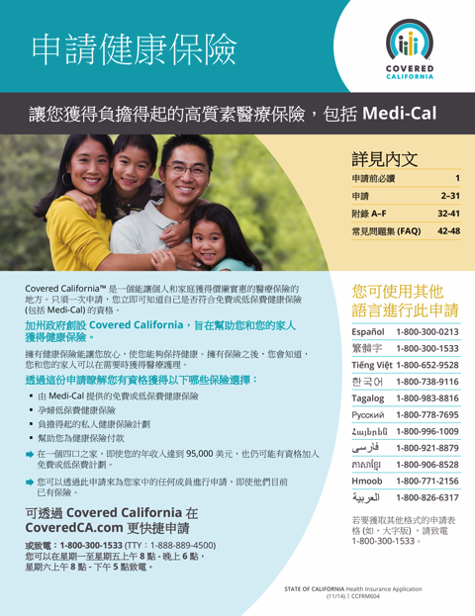
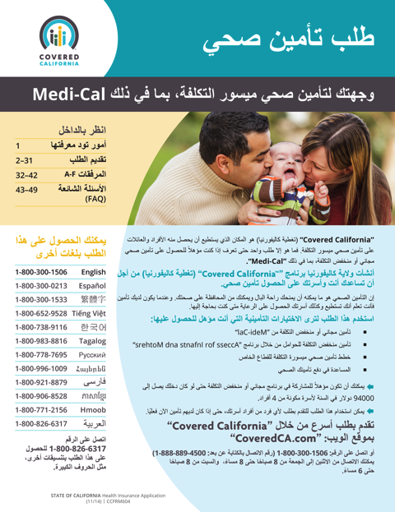
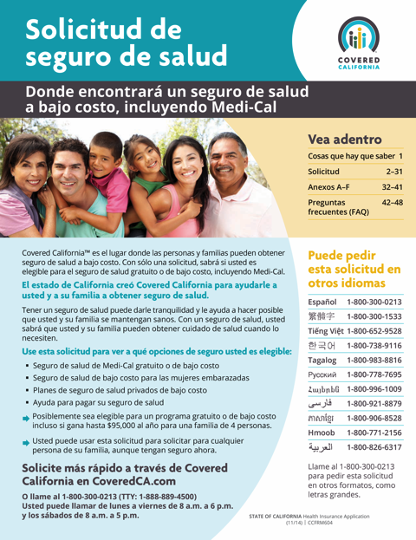
A Focus on the Consumer Experience
MAXIMUS Center for Health Literacy
Plain Language Communication
Content at a sixth grade level
User-friendly and intuitive designs
Translation Services
Adaptive translations
Cultural and linguistic relevancy
Research and Community Testing
Focus groups
Community surveys

Slide 10
Rhode Island Program Campaigns

Slide 11
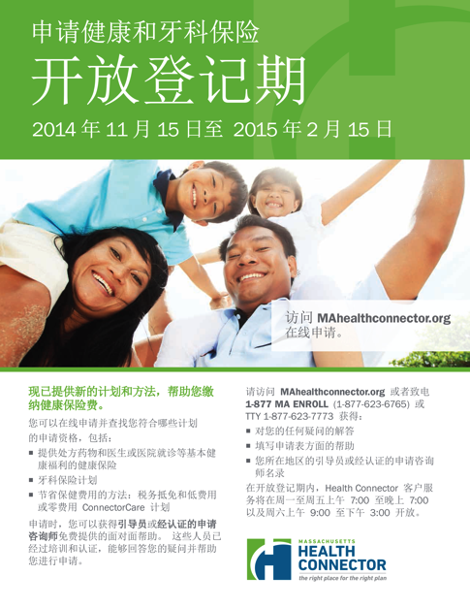
Massachusetts Health Connector Collateral

Slide 12
For more information
www.maximus.com/chl
healthliteracy@maximus.com
@health_literacy

